Slide 1

Project iCON System walkthrough
Mumbai
January 2017

Slide 2
I. Business flow

Slide 3
What is iCON
iCON stands for international CONtract Management system
Developed for Daimler
Serves after-sales operations
Intended consumers are dealers; their salesmen and workshops
iCON was handed over to CapGemini from another major IT player
iCON currently handles tenant specific operations
Data can be extracted from iCON for reporting purposes

Slide 4


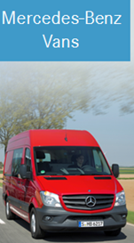
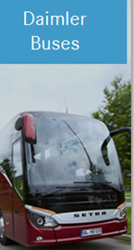

Lines of Business

Slide 5
TP coverages
TP | Coverage
TP1 | Quote, Proposal, Contract modifications
TP2 | MPD, activation, termination, revenues
TP3 | Costs, internationalization, DDE
TP4 | CCC, Print, Search, Roles and Rights ..
TP6 | Data maintenance

Slide 6
Business entities
HQ
MPC
Dealer, Workshop

Slide 7
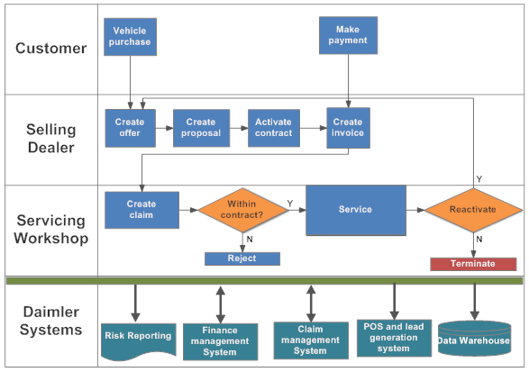
Business use case

Slide 8
Roll out markets
Belgium
UK
Germany
China
France
Brazil
Live markets
Roll-out markets
Future markets
8

Slide 9
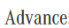
Service contract variants
For the security oriented and price-conscious customers
The maintenance contract is for customers with a focus on cost transparency and predictability
The Service Contract option "all inclusive package" include all maintenance, repairs, wear and tear during the agreed term

Slide 10
System integration
Service Contract
sales
Service contract calculation and release
Service contract management
Invoicing
Claim
processing
Service contract process controlling
iCON
iCON
POS
POS
/
ASM
Retailer
EVA
Sales Organisation (for CVs: CW)
AQUA
Local After Sales
CoFiCo/NACOS
VEGA
GSP
Controlling
VERA
SCARF
Master data
Products
Costs
Prices
Vehicle build
Damage codes
Work codes
Part numbers
iCON to-be Processes
Central System
Integration in POS
iCON System

Slide 11
iCON Process Descriptions
1. Service Contract sales
Data is supplied for costing, pricing and vehicle master data
Supply of a service for offer generation in POS
Separate calculation methods for trucks, vans, cars etc.
Market-specific options
2. SC calculation and release
Contract acceptance by mutual declaration of intention
Adaption and confirmation workflow for special cases

Slide 12
iCON Process Descriptions
3. SC management
Contract activation
Customer and contract administration
Contract extension
Contract termination
Contract takeover
Administration of contract-related products (fuel cards, etc.)
4. Invoicing
Automatic invoicing
Costing
(Profit-Sharing)
Workshops

Slide 13
iCON Process Descriptions
5. Claim processing
SC processing via EVA/VEGA
Workshop loyalty
Contract-specific compensation rates
Operational monitoring (HQ, MPC, Retail)
iCON reporting by data supplying process to AQUA for HQ
Risk assessment by data supply to SCARF
Standard interface to local reporting system
6. SC process controlling

Slide 14

Interaction with disparate systems
Enabling Reporting
Enabling Sales
AQUA
MBC POS
CLAI costs
feedback
EVA/VEGA
CoFiCo
PUE
MDS/GO
Scarf
VeDoc
MBKS
Improvement financial
Processes and claiming
Enabling Master Data

Slide 15
AQUA
Reporting data:
Cost
Damage
Service coverage
Product data
Consumer data
Dealer Data
Enabling Reporting for
HQ and MPC
AQUA

Slide 16
POS
Direct interface to ‘create quote’ and ‘create proposal’
iCON acts as master data
Data fetched
Product data
Price data
Enabling Sales for
ePOS and other sales systems
MBC POS

Slide 17
Master data
VeDoc
Interface to fetch master data
Provides built data on existing vehicles
MDS/ GoPPM/ PUE
Interface for sales oriented data
MDS: commercial master data
GoPPM: passenger car master data
PUE: after-sales master data
MBKS: pricing and vehicle master data
PUE
MDS/GO
VeDoc
MBKS
Enabling Master Data

Slide 18
Financial systems
CoFiCo
Interface for payment data related to claims
Data pulled from iCON + SIRIUS
Provides cost data as basis for booking
2. VEGA
Interface for the warranty system of claims and damages
Helps create balance sheet of cost and revenues
3. Scarf
Interface for risk forecasting and cost accruals
Provides SC data, revenue and invoice data
CLAI costs
feedback
EVA/VEGA
CoFiCo
Scarf
Improvement financial
Processes and claiming

Slide 19
II. Development team
(On shore – Off shore model)

Slide 20
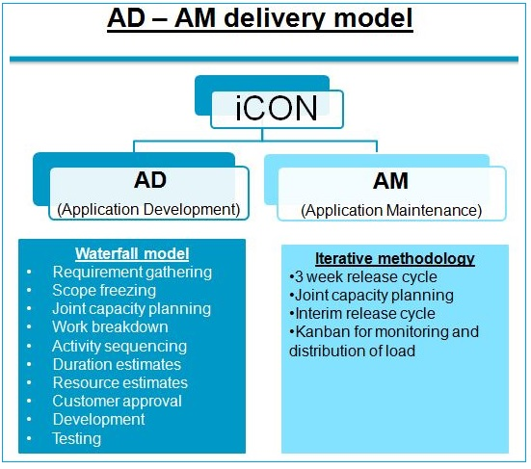
Delivery models

Slide 21
Application delivery
Model driven approach
IBM RSA (Rational Software Architect) required for model creation
Model design completed by BA
Model completes major % of code generation
Nightly build runs for code generation
MAVEN provides read-only view of model and explanation

Slide 22
Development & Testing environments
4 internal environments
CGDev1
CGDev2
CGDev3
CGDev4
5 external environments
DiaDev1
DiaDev2
DiaDev3
DiaDev4
DiaDev5
Note: To view current status of all servers, go to Confluence > Technical > Environments > Current env. Status
https://seu.sdm.de/pu/daimler/build/confluence/display/ICON

Slide 23
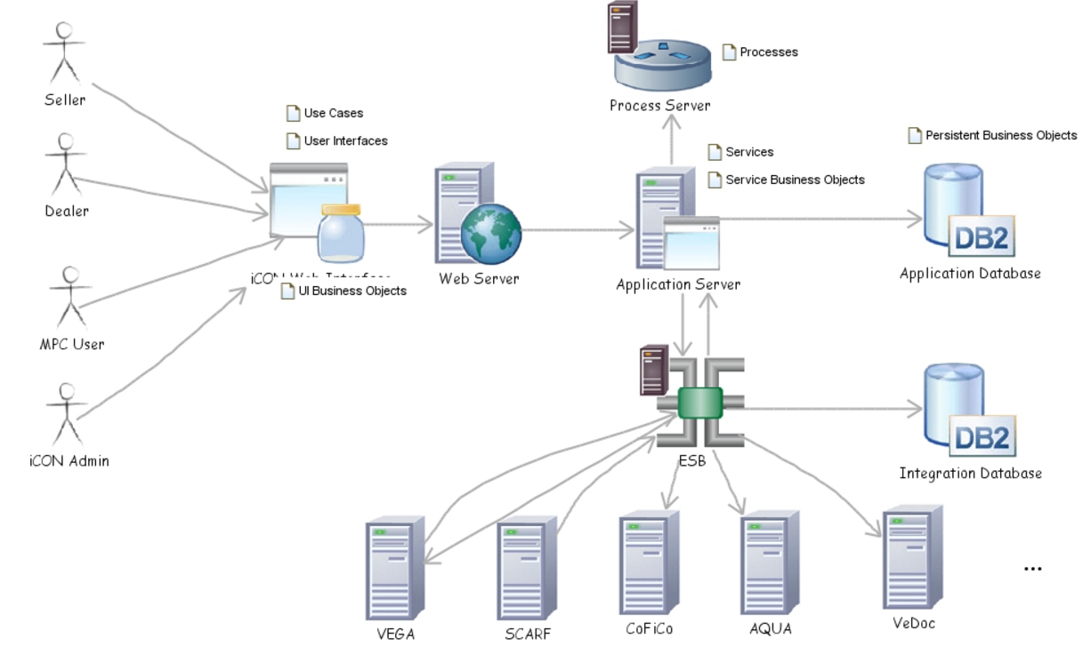
Entity Relationship for server architecture

Slide 24
Delivery process
Input
Process
Output
Requirement
ALM tool
Intake checklist
IBM RSA
Analysis & Estimation
Discussions
Walkthrough
Impact analysis
Dependency matrix
Change Request
CR document
PD estimates
BA
Analysis
Kick off meeting
Test scenarios
Discussions
Impact analysis
LLD
Low Level Document (LLD)
Reverse KT
Tester + Tech leads
CR document
Development
Test cases
Functional review
Estimates
Coding & Junits
Planning & tracking
Dev team + testers
Code release
Source code
Test cases
LLD
BA + Testers
Source
code
TC validations
SIT, Expert, Ad-hoc testing
Quality gates
Pre UAT demo
Test report

Slide 25
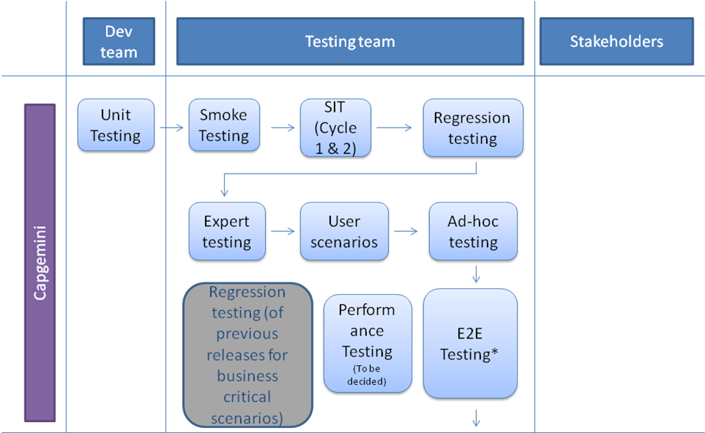
Quality measures : Testing process

Slide 26
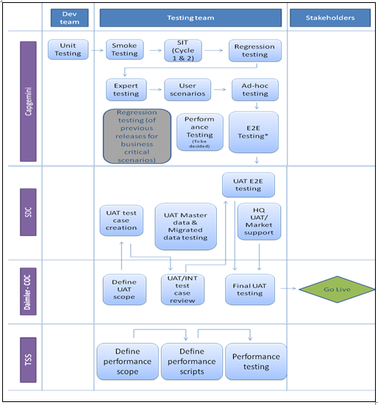
Quality measures : Testing process

